Slide 1

Secure National ID Management System
Presented By: Neural Scope
Md. Meahadi Hasan (ID: 0322310105101034)
Md. Sohanur Rahman(ID: 0322310105101039)
Arafat Rahman (ID: 0322310105101052)

Slide 2
Introduction
What is the National ID Management System?
A software solution designed to manage citizen data efficiently and securely.
Built using C Programming Language for performance and reliability.
Provides functionalities like citizen registration, data updating, searching, and auditing.
Why is it Important?
Ensures secure storage and management of sensitive citizen information.
Facilitates quick access to citizen data for administrative purposes.
Maintains an audit trail for accountability and transparency.
Why It Matters:
Critical for government services, voting, healthcare, and legal processes.
Combats identity fraud through structured validation and encryption.

Slide 3
Key Features
1. Citizen Registration:
Collects and stores citizen details like name, DOB, gender, address, and more.
Automatically generates a unique 10-digit National ID (NID) for each citizen.
2. User Authentication:
Secure login system for administrators using password hashing and salting.
Prevents unauthorized access.
3. Data Management:
Allows updating, deleting, and searching citizen records.
Ensures data integrity and security.
4. Security Measures:
Uses OpenSSL cryptography for password security.
Prevents unauthorized access with login attempt restrictions.

Slide 4
Page 4
5. Audit Logs:
Tracks all activities (e.g., registration, updates, deletions) with timestamps.
Enhances accountability and transparency.
System Architecture
1. Data Structures:
Citizen: Stores citizen details (name, NID, DOB, address, etc.).
SystemUser: Manages admin credentials and roles.
ActivityLog: Tracks all system activities.
2. Core Modules:
Admin Module: Handles citizen registration, updates, deletions, and audit logs.
Authentication Module: Manages secure user login and password management.
Utility Module: Provides helper functions (e.g., date validation, NID generation).

Slide 5
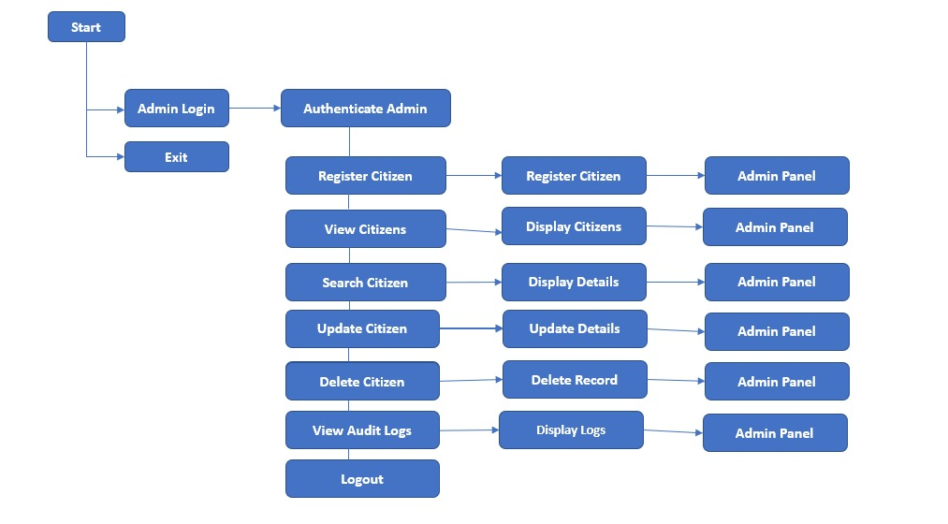
Page 5
3. Security Features:
Password Hashing: Uses SHA-256 for secure password storage.
Salting: Adds random data to passwords to prevent rainbow table attacks.
Audit Trails: Logs all critical activities for monitoring.
Flowchart

Slide 6
Workflow Overview
Admin Login → Authenticated using SHA-256 hashed passwords.
Register Citizen → Unique National ID (NID) is generated automatically.
Search Citizen → Admin can retrieve citizen details by NID.
Update/Delete Citizen → Admin can modify or remove citizen records.
Audit Logging → Records every important system activity for security.

Slide 7
Future Enhancements
1. Database Integration:
Replace arrays with a database (e.g., MySQL, PostgreSQL) for scalability.
2. User Roles:
Add more roles (e.g., Officer, Auditor) with restricted access.
3. GUI Development:
Develop a graphical user interface (GUI) for better user experience.
4. Advanced Security:
Implement two-factor authentication (2FA) for admin login.
Add fingerprint/face recognition for authentication.

Slide 8
Conclusion
The National ID Management System is a secure, efficient solution for managing citizen records.
Uses C programming, OpenSSL encryption, and structured data handling.
Future updates can make it even more scalable and user-friendly.
Foundation for scalable citizen identity solutions.

